Slide 1
Power BI Report Deployment Guidelines
November 2024
Teruyuki Ito
Reporting & Data Visualisation Manager

Slide 2

Introduction
This document outlines the steps required to deploy Power BI reports using the Power BI Deployment Pipeline.
The deployment pipeline is a feature in Power BI Service that allows you to streamline the development, testing, and deployment of Power BI reports across different environments like Development, Test (Staging), and Production.
Development
Test
Production

Slide 3

Benefits
Structured user acceptance testing before production release
Controlled content progression through development stages
Reduced risk of exposing unfinished or untested content to end-users
Isolation of development and testing activities from production environments
Opportunity to use different data sources for each stage

Slide 4

Prerequisite
Before deploying Power BI reports, ensure the following prerequisites are met:
Power BI Service Premium or Premium Per User (PPU) license is required for using deployment pipelines.
Power BI Workspace for each environment:
Development
Test (Staging)
Production
The user performing the deployment must have Admin or Member permissions in the workspaces.
Reports and datasets should be prepared and published to the Development Workspace.

Slide 5

Development Workspace
The development workspace is where initial report creation and ongoing modifications take place. Key aspects include:
Access limited to developers and administrators
Used for creating new content and making changes to existing reports
Connects to development or sample data sources
Allows for experimentation and frequent iterations
Not accessible to end-users or testers

Slide 6

Test Workspace
The test workspace serves as an intermediary stage for quality assurance and user acceptance testing. Its characteristics include:
Access granted to developers, administrators, and UAT testers
Used for data validation and functionality testing
Typically connects to test or UAT data sources that mirror production data
Allows stakeholders to review and approve content before production release
May have an associated app for easier access by testers

Slide 7

Production Workspace
The production workspace is the final stage where approved content is made available to end-users. Key features include:
Contains only thoroughly tested and approved reports and dashboards
Access restricted to administrators and select developers
Connects to live production data sources
Associated with a production app for distribution to end-users
Subject to stricter change management processes
Monitored for performance and usage metrics

Slide 8
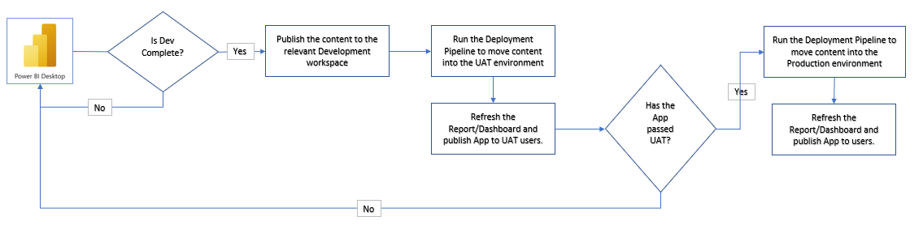
Typical Workflow

Slide 9
Best Practices

Slide 10







General Best Practice
Backup Workspaces
Data Source Configuration
Each environment should be configured with the correct data sources.
Development: Use sample or development datasets.
Test: Use data that is similar to production data.
Production: Use live production data.
Maintain backups of all Power BI reports and datasets in case a rollback is needed.
Consistent Naming Conventions
Row-Level Security
Prefix the workspace name with the division such as ESD or CEN. Followed by a workspace name and postfixed with the workspace posture, e.g. [Dev] or [Test] , Ex. CEN_Technology [Dev]
Test RLS configurations thoroughly in Test before deploying to Production.
Automated Refreshes
Version Control
Configure automatic refreshes in Test and Production environments to ensure data is up to date.
Track changes to reports and datasets through versioning to ensure that you can identify which versions have been deployed.
Ex. Data Retention_v2

Slide 11
Report Colourisation
A banner will be displayed on top of the report and connected to the deployment pipeline through parameterisation.
Development reports:
Grey header banner
Test reports:
Amber header banner
Production reports:
Hidden banner

Slide 12


Report Endorsement
To ensure users are aware of the difference between operationally endorsed reporting, i.e. thought that have been designed and developed with the DnA team, verses those developed by other developers reports need to be marked appropriately.
DnA Reports & Datasets will be marked by either;
Certified:
This is the highest level of endorsement, considered highly reliable and are usually business-critical. Only authorized users can certify reports.
Promoted:
This endorsement is for reports that are considered useful and have been validated, but may not go through the same rigorous certification process.

Slide 13

Data Classification
In Power BI, data classification refers to the practice of categorizing and labelling data based on its sensitivity or confidentiality level. On top of complying on the ISO standards, this feature helps us in protecting our data by ensuring that our stakeholders and clients are aware of the nature and appropriate use of the data they are interacting with.
The Maximus classifications are as follows;
Sensitive
Official
Public

Slide 14

Access Control
Utilise Active Directory (AD) groups for report access management instead of hard-coded permissions
Create separate AD groups for each report or report category
Regularly review and update AD group memberships

Slide 15

Automation of UAT
We can use Power Automate to automate the sign-off and UAT approval process. Power Automate allows to create a workflow where reviewers are notified to review and sign off on the reports developed by DnA.

Slide 16

DnA Reports Differentiator
Report Endorsement (Certified and Promoted Reports) - Users will see a badge or label indicating that the report is either Certified or Promoted when they search for or view reports in Power BI.
Metadata and detailed descriptions - These will be written on the report description to clarify who developed them and their purpose
Info Icon - There will be a relevant contact information, such as the DnA team's email or the BI manager responsible for the report, embedded on the info button at the top of the report. This reinforces the identity of the report as coming from a specific department and provides a point of contact for users with questions.

Slide 17

Support Sign-off
Before a report can be deployed to production:
The team developing the report must formally agree to provide ongoing support
DnA team must review and approve the support agreement
Document the support arrangement, including:
Primary contact person(s)
Escalation procedures
Expected response times

Slide 18

Deployment Checklist
[ ] Report developed in Development Workspace.
[ ] Ensure that the dataset is published along with the report.
[ ] Setup data refresh configuration, including data gateway it the data source are on-premises.
[ ] Appropriate colourisation is applied.
[ ]Data classification and endorsement label are applied.
[ ] UAT conducted in UAT Workspace.
[ ] Stakeholder approval is obtained.
[ ] AD groups created and configured.
[ ] Support agreement signed.
[ ] DnA team review is completed.
[ ] Final deployment to Production Workspace.

Slide 19

Report Usage Monitoring
Utilise the Usage Metrics report in Power BI, a pre-built report that shows how content is being used over the past 90 days.
It can help us:
Understand User Engagement: Report usage monitoring helps identify which users or departments are actively using the reports and how frequently they are accessing them.
Track how reports are shared: Monitoring report usage helps to keep track of who is accessing the shared reports, ensuring that reports are shared responsibly and securely.
Analyse report reach: How far a report has been distributed within the organization and whether it’s reaching its intended audience.

